Slide 1

Predicting Diabetes
Rj Reichhard
dsc 630: predictive Analytics

Slide 2
Introduction to diabetes
Condition in which the body does not produce insulin or cannot utilize insulin properly
Type 2 – most common
Untreated diabetes can lead to heart, eye, teeth/gum, feet, skin, kidney, & circulatory system damage
More than 1 in 10 adults have diabetes
25% of adults >65 years of age

Slide 3
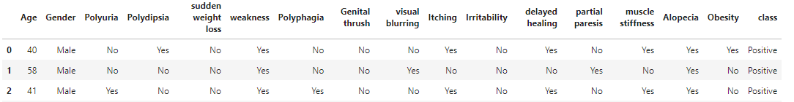
dataset
Polyuria – excessive urination
Polydipsia – excessive thirst
Polyphagia – excessive appetite
Thrush – a fungal infection
Partial Paresis – muscle weakness
Alopecia – sudden hair loss
Dataset obtained from the University of California Irvine Machine Learning Repository (link in references)
Compilation of 500+ patient records
No identifying information for individual patients

Slide 4
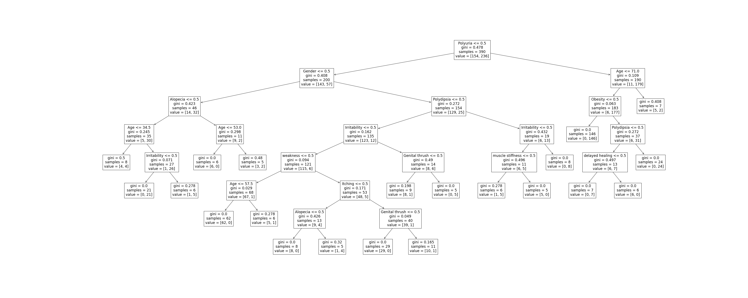
First classifier algorithm: decision tree

Slide 5
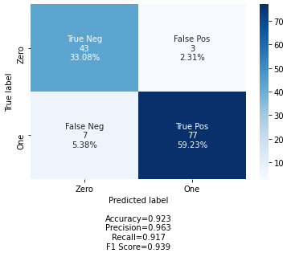
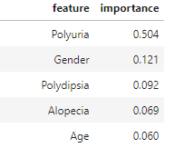
First classifier algorithm: decision tree
The Decision Tree Classifer had an accuracy of 92.3% when comparing the predicted class vs the true class
5.38% False Negative is concerning, we can do better

Slide 6
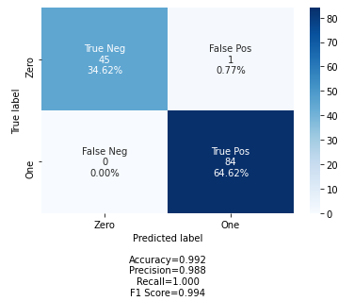
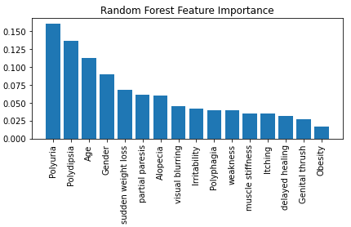
second classifier algorithm: Random Forest
Random Forest first fitted to training data using GridSearch CrossValidation
Using the best parameters from the GridSearch, a second Random Forest was fitted
Accuracy increased to 99.2% when comparing the predicted class vs the true class
0% False Negative, and only 1 False Positive

Slide 7
conclusions
Winning Classifier – Random Forest
Prioritizing not only accuracy, but lack of False Negatives
New data records could be applied to the classifier and we can assume a 99%+ accuracy for predicting diabetes
If needed, to lower the amount of information needed for each record the top 4 most important features could be gathered alone instead

Slide 8
references
Abbott, D. (2014). Applied predictive analytics: principles and techniques for the professional data analyst. Wiley.
American Diabetes Association. (2019). Diabetes Overview - Symptoms, Causes, Treatment. Diabetes.org. https://www.diabetes.org/diabetes
Brownlee, J. (2020, April 7). 4 Types of Classification Tasks in Machine Learning. Machine Learning Mastery. https://machinelearningmastery.com/types-of-classification-in-machine-learning/
K, G. M. (2020, August 30). Machine Learning Basics: Support Vector Machine (SVM) Classification. Medium. https://towardsdatascience.com/machine-learning-basics-support-vector-machine-svm-classification-205ecd28a09d
Leung, K. (2019, November 20). How to Code and Evaluate of Decision Trees. The Startup. https://medium.com/swlh/how-to-code-and-evaluate-of-decision-trees-2d94093b3c1a
Lutz, J., Hess-Fischl, A., & Leontis, L. M. (2009, May 26). What Is Type 2 Diabetes? Endocrineweb.com; EW. https://www.endocrineweb.com/conditions/type-2-diabetes
Starmer, J. (2019, September 30). Support Vector Machines Part 1 (of 3): Main Ideas!!! Www.youtube.com. https://www.youtube.com/watch?v=efR1C6CvhmE
UCI Machine Learning Repository. (2022). Uci.edu. https://archive-beta.ics.uci.edu/ml/datasets/early+stage+diabetes+risk+prediction+dataset

